Slide 1
Bike Sharing Demand Analysis
Submitted by Iram Shafi

Slide 2
Problem Statement
Analyze bike rental data.
Study impact of weather & time.
Improve decision-making.

Slide 3
Dataset Description
Multiple datasets used.
Hourly & daily data
Combined dataset 1 and dataset 2 and merged in dataset A, then combined dataset A with dataset 3 and finalized a last final dataset.
Created different charts on dataset A and final dataset to show the data clearly.

Slide 4
Data Cleaning
(Used Excel sheets like DATASET1, DATASET2, DATASET A, DATASET 3, AND FINAL DATASET.)
Removed duplicates and corrected data types.
Handled missing values
Import datasets and merged on common keys (instant, date/day, hr) via Power Query or by using formulas (VLOOKUP/INDEX-MATCH).

Slide 5
Tools & Functions Used
Excel formulas (SUM, AVERAGE).
VLOOKUP / INDEX-MATCH.
Conditional formatting.
Used COUNTIF, SUMIF, STDEV, CORREL functions for statistics.
Used IF statements for conditional classification (e.g., weekend vs weekday, different weather situations).
● Apply VLOOKUP, INDEX, MATCH to link and extract data from tables.

Slide 6
Data Analysis
Used KPI, and Statistical functions like CORRELATION and STANDARD DEVIATION Sheets.
Created pivot tables and pivot charts to summarize user demand by time, weather, or user type.

Slide 7
Data set A – Chart 1 & 2

Slide 8
Dataset – Chart 3 & 4

Slide 9
Final Dataset – Chart 1 & 2

Slide 10
Final Dataset – Chart 3 & 4

Slide 11
Statistical Functions
CORRELATION
ST. DEVIATION
(Temp, T.count) 0.22929
(Hr, T.count) 0.366047
(Temp, T.count) 46.29672
(Hr, T.count) 43.18472

Slide 12
Dashboard
Build interactive dashboards combining multiple charts (line, bar, funnel, heatmaps) in different datasets.
Added KPI of total count, registered count & casual count.
Showed statistical functions value like Correlation and st. deviation of different sectors (e.g, hr, count, temp, humidity, windspeed etc.)
Added slicers and timelines for filtering dashboards dynamically.

Slide 13
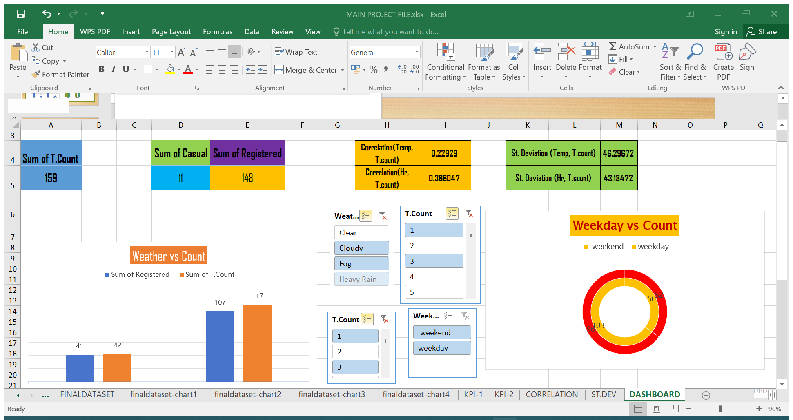

Slide 14
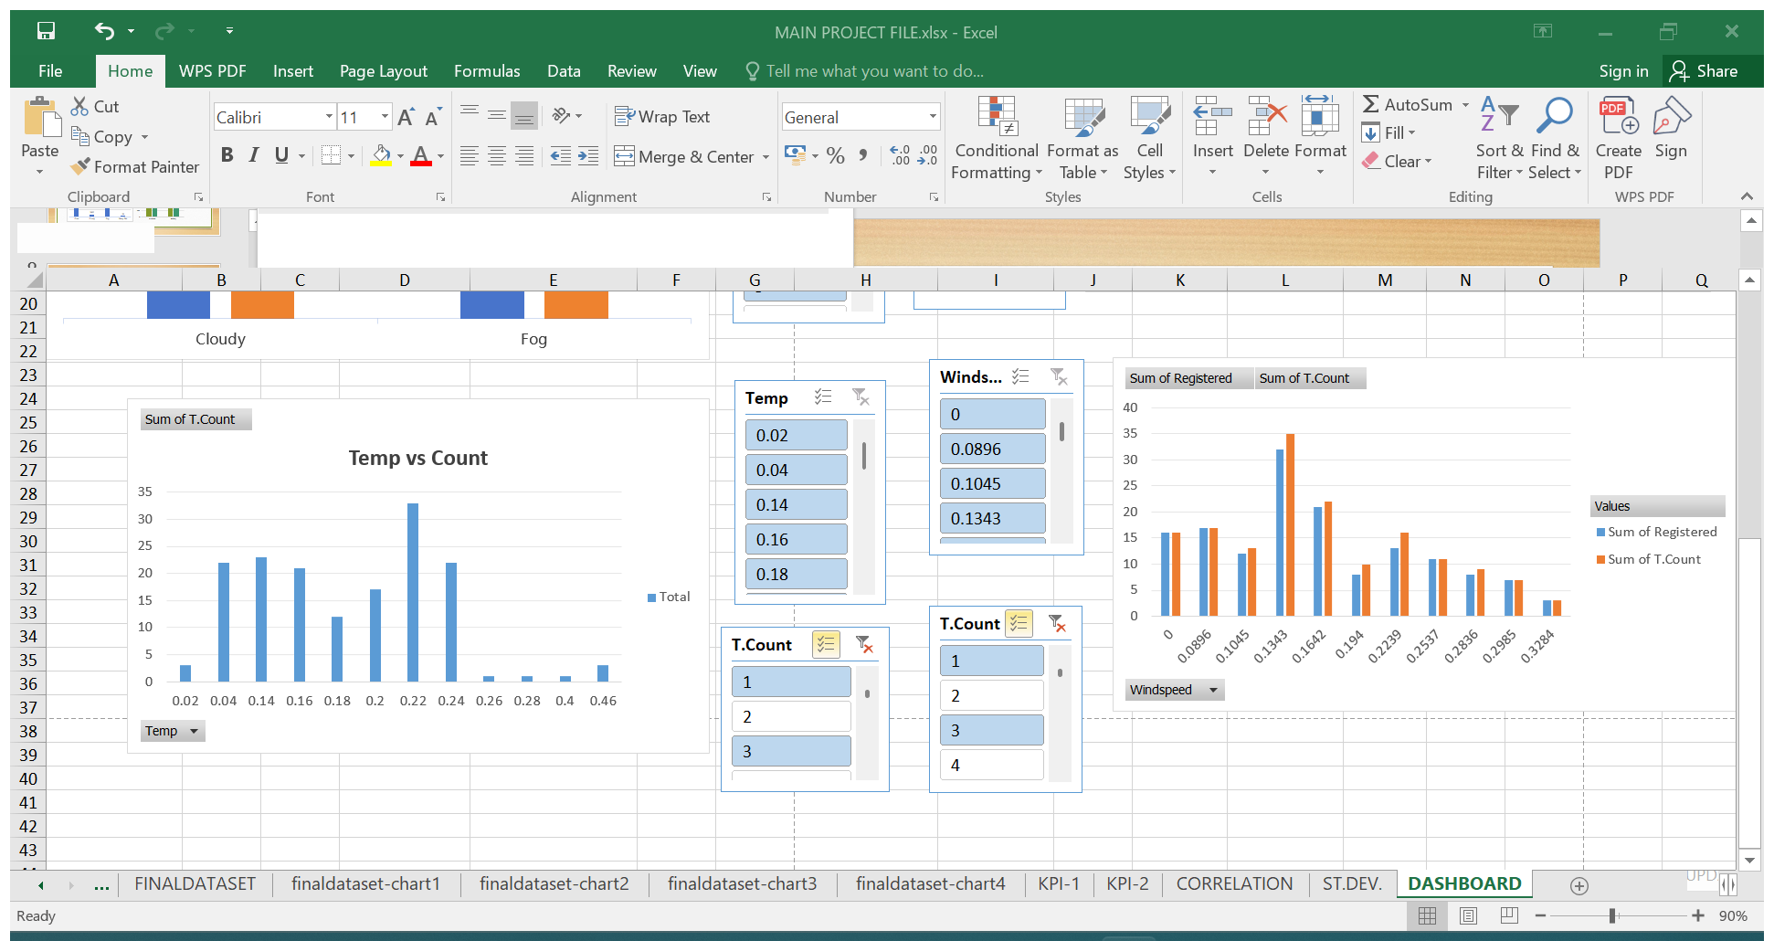

Slide 15
Key Insights. (Main points)
Demand depends on weather, time, and season and changes with weather.
Peak use during commuting hours identified.
Data helps predict and improve bike sharing systems.
User trends observed.

Slide 16
Conclusions
This project helped in gaining valuable knowledge and practical experience.
It demonstrates the significance of the topic and its real-life applications.
The objectives of the project were successfully completed.

Slide 17
Conclusions
The analysis shows that bike sharing demand is strongly influenced by
factors such as weather, season, time of day, and day type (working day vs
holiday).
Demand is generally higher during pleasant weather conditions and lower during
extreme conditions like heavy rain or high humidity.
Peak usage occurs during commuting hours, indicating that bike sharing is widely
used for daily transportation.

Slide 18
Conclusions
Seasonal trends reveal that demand increases in warmer months and
decreases in colder or unfavorable seasons.
The study confirms that data analysis techniques can effectively predict demand
patterns, helping in better resource planning and bike distribution.
Proper demand forecasting can help operators optimize availability, reduce
shortages, and improve customer satisfaction.

Slide 19
Thank You !

